Slide 1
CareerLens
CAPSTONE PROJECT
Presented By:
Student Name- Yash Padhiyar
College Name- GLS University
Department - FCAIT
4. AICTE ID - STU6a435bc54ebd01782799301

Slide 2
OUTLINE
Problem Statement (Should not include solution)
Proposed System/Solution
System Development Approach (Technology Used)
Algorithm & Deployment
Result
Conclusion
Future Scope
References

Slide 3
Problem Statement
Choosing the right career can be difficult because students may not know which career best matches their skills, interests, and abilities.
Most career guidance gives general suggestions, but it does not clearly show which skills a person is missing or what they should learn next.
CareerLens aims to solve this problem by using Machine Learning and O*NET data to recommend suitable careers, identify skill gaps, and suggest skills to improve.

Slide 4
Proposed Solution
The proposed system aims to help users find suitable career options based on their skills, abilities, interests, and work preferences. The system uses Machine Learning and O*NET occupational data to provide career recommendations and identify areas for improvement.
Data Collection:
  Use O*NET 29.1 occupational data. Collect information about skills, abilities, knowledge, work styles, and career interests.
  I have used data for 878 occupations.
Data Preprocessing:
  Combine data from different O*NET files. Handle missing and inconsistent values.
  Select relevant features and create a 147-feature profile for each occupation. Apply feature scaling before using the ML models.
Machine Learning Algorithm:
  I Use KNN with cosine similarity to find the top 5 occupations that best match the user's profile.Use Random Forest to predict the broader career field.
  Compare different ML models to select the better-performing approach.
Deployment:
  A user-friendly web application using Streamlit that allows users to enter their skills, abilities, interests, and work preferences and receive career recommendations.
Evaluation:
  Evaluate the models using Test Accuracy and Cross-Validation Accuracy to measure their classification performance. Different models are compared to identify the best-performing model for career-field prediction
  For occupation recommendation, the KNN model is evaluated based on the relevance of the top matching occupations.
  Result: CareerLens successfully recommends the Top 5 occupations based on the user's profile and identifies the most suitable career field. It also provides skill-match analysis, skill gaps, and a personalized learning roadmap to help users understand and improve their career readiness.

Slide 5
System Approach
System Approach
  The CareerLens system is developed to analyze a user's profile and recommend suitable career options. The system combines O*NET occupational data with machine learning techniques to compare the user's profile with existing occupation profiles.
System requirements
  Hardware Requirements:
    Processor: Intel Core i3 or equivalent
    RAM: 4 GB or above
    Storage: At least 2 GB free space
  Software Requirements:
    Operating System: Windows / Linux / macOS
    Python 3.9 or above
    Streamlit for the web application Jupyter Notebook or VS Code for development
Library required to build the model
    Pandas – for loading, cleaning, and handling the O*NET datasets
    NumPy – for numerical operations and feature processing Scikit-learn – for KNN, Random Forest, Gradient Boosting, StandardScaler, and model evaluation Joblib / Pickle – for saving and loading the trained model Streamlit – for developing the interactive web application OpenPyXL – for handling Excel files when required

Slide 6
Algorithm & Deployment
In the Algorithm section, describe the machine learning algorithm chosen for predicting bike counts. Here's an example structure for this section:
Algorithm Selection:
  K-Nearest Neighbors (KNN) is used as the primary algorithm for career recommendation. It compares the user's profile with occupation profiles using cosine similarity and returns the Top 5 closest occupations.
  Random Forest is used as a secondary model to classify the user into one of the broader career fields.
Data Input:
  The system uses 147 features from the O*NET 29.1 database, including: Essential skills Abilities Knowledge Transferable skills Work styles Career interests (RIASEC) The user's inputs are converted into the same feature format before making recommendations.
Training Process:
  The O*NET occupation data is cleaned and combined to create a profile for each occupation. The features are scaled using StandardScaler before applying the machine learning models.
  Different models, including Random Forest, Gradient Boosting, and KNN, are compared using test accuracy and cross-validation to evaluate their performance.
Prediction Process:
  When a user enters their profile, CareerLens compares it with the 878 occupation profiles using KNN and cosine similarity. The system ranks the occupations based on similarity and displays the Top 5 matches. The Random Forest model also predicts the user's broader career field.

Slide 7
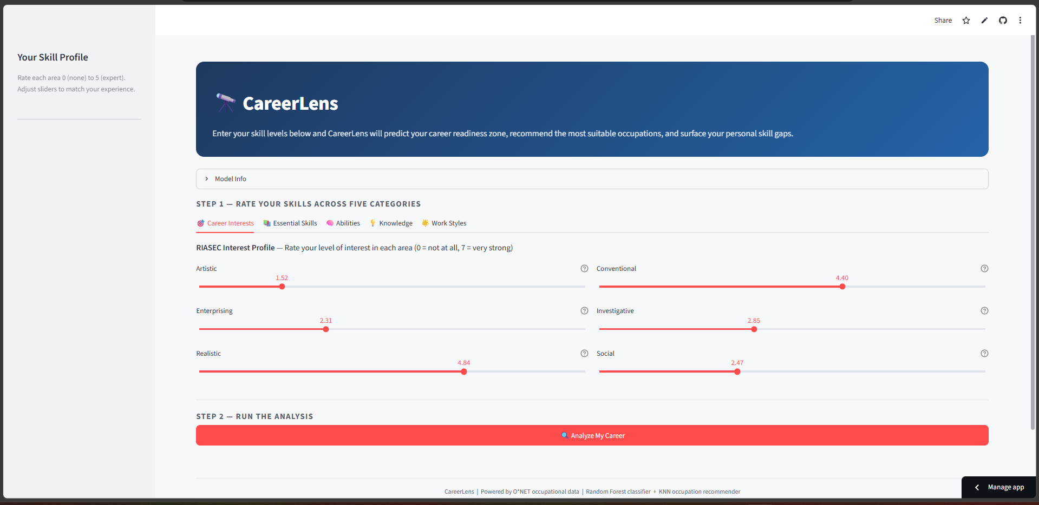
Result

Slide 8
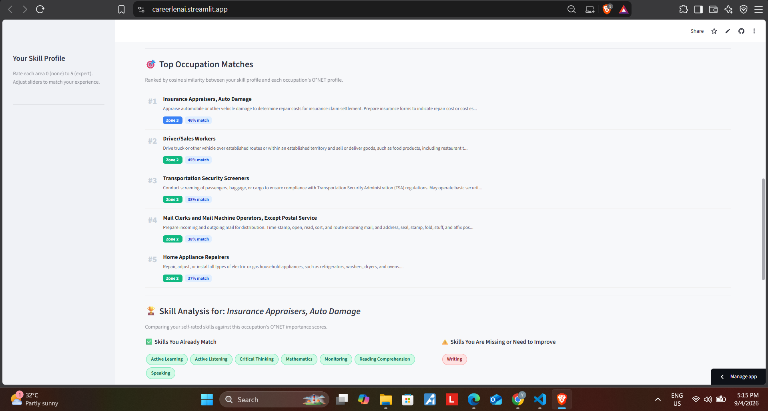
Result

Slide 9
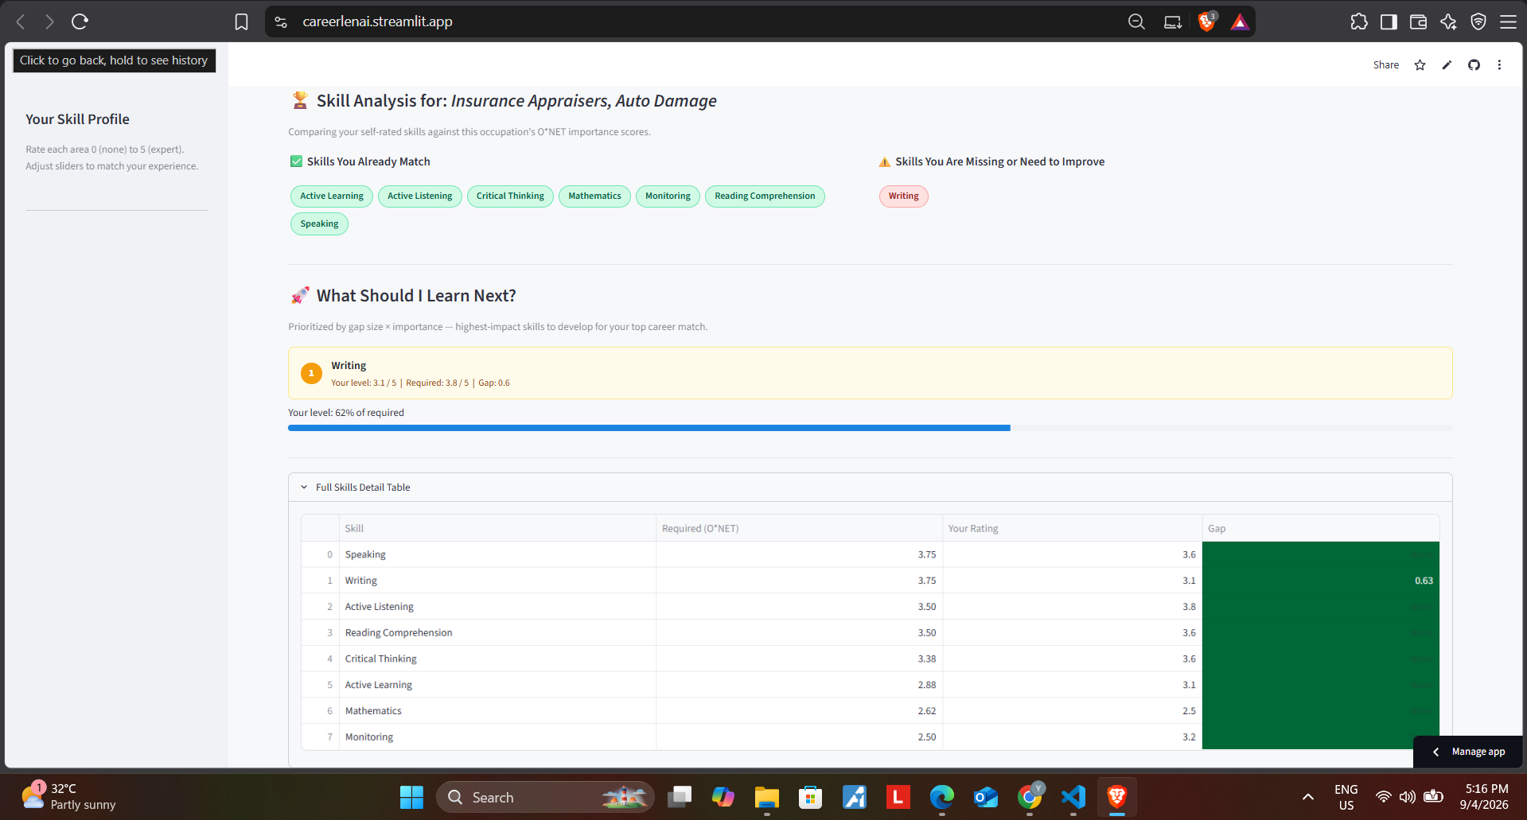
Result

Slide 10
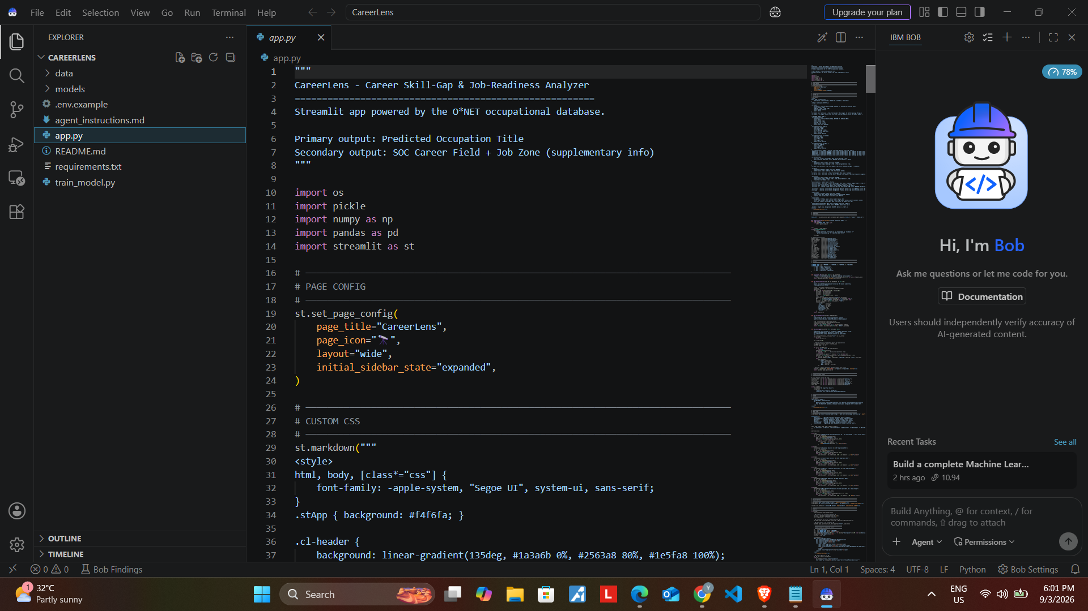
Result

Slide 11
Conclusion
CareerLens provides personalized career recommendations using real O*NET 29.1 data.
It uses Machine Learning to match a user’s skills, abilities, interests, and work preferences with suitable occupations.
Skill-match and skill-gap analysis help users understand their strengths and areas they need to improve.
One of the main challenges was combining and preprocessing data from multiple O*NET datasets.
The system can be improved in the future by adding resume analysis, live job-market data, course recommendations, and salary/location-based suggestions.

Slide 12
Future scope
Add more information such as salary, job demand, and current industry trends to make the recommendations more useful.
Improve the recommendation model by trying better ML techniques and comparing their performance.
Allow users to upload their resume so the system can identify their skills automatically.
Suggest courses and certifications based on the skills the user needs to improve.
Add location-based recommendations to help users find careers and jobs in their preferred area.
In the future, AI can be added to give users more personalized career guidance and explanations.

Slide 13
References
O*NET Resource Center — O*NET 29.1 Occupational Database
https://www.onetcenter.org/database.html
Pedregosa et al. (2011) — Scikit-learn: Machine Learning in Python, JMLR
https://jmlr.org/papers/v12/pedregosa11a.html
Breiman, L. (2001) — Random Forests, Machine Learning
https://doi.org/10.1023/A:1010933404324
Python Documentation — Python 3
https://docs.python.org/3/
Pandas Documentation — Data Analysis and Manipulation
https://pandas.pydata.org/docs/
Streamlit Documentation — Web Application Development
https://careerlenai.streamlit.app/
GitHub — Project source code and version control
https://github.com/yashhcoder/CareerLens.git

Slide 14
Deployment link / github link
Github Link: https://github.com/yashhcoder/CareerLens.git
Deployment: HF, Streamlit Link, Gradio (OPTIONAL)
Streamlit ; https://careerlenai.streamlit.app/

Slide 15
THANK YOU

